Slide 1
BPT2633

Slide 2
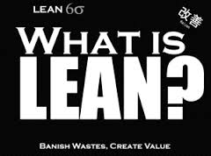

Slide 3
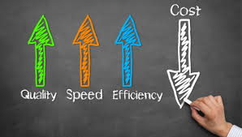

Slide 4
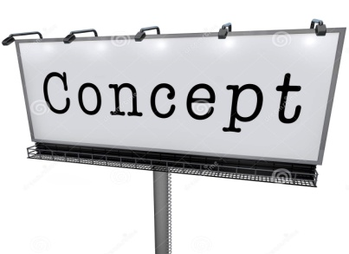
The core idea is to maximize customer value while minimizing waste. Simply, lean means creating more value for customers with fewer resources.
A lean organization understands customer value and focuses its key processes to continuously increase it. The ultimate goal is to provide perfect value to the customer through a perfect value creation process that has zero waste.
www.lean.org

Slide 5
